Slide 1
Development of an Online Tool for the Creation and Analysis of Feature Models for Software Product Lines
Harry Scutt
Supervisor: Dr José Miguel Rojas
COM3610 Dissertation Project

Slide 2
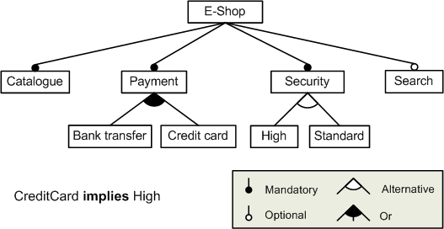
Technical Background:
Software Product Lines:
Feature Models:
Describe a family of similar systems.
Systems comprise of modular components that can be configured to fit needs.
Help reduce development time and lifecycle costs.
Emphasise reusability and robustness.
Can reduce frequency of bugs in a software family.
Leads to increased developer productivity.
Product lines often represented as a Feature Model (right).
Help clearly communicate the relationships and constraints between components.
Enable simple visual check for completeness.
Reduce the level of technical knowledge required to understand the product family – suitable for clients.
Enable analysis to be run on a product line, providing insight into the scope of a product family.
Simple E-Shop to demonstrate the language of feature model diagrams.

Slide 3
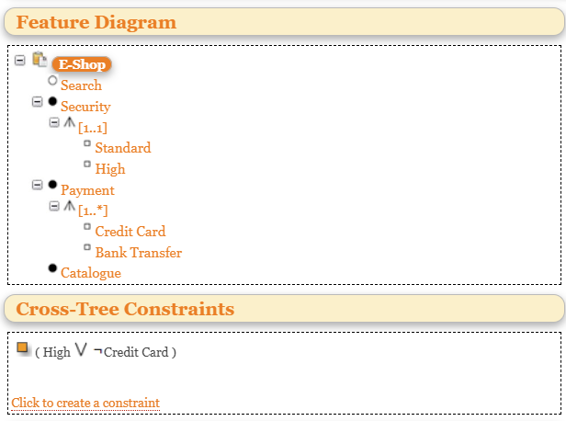
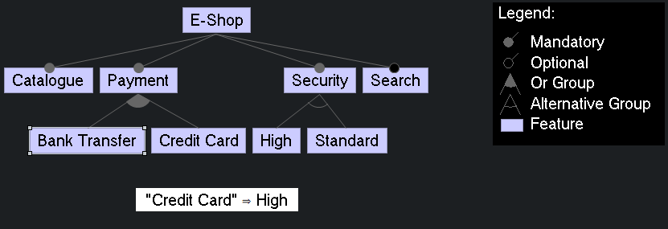
Existing Solutions:
SPLOT:
Most popular solution.
Features large database of feature models.
Unintuitive and clunky to use.
Hasn’t been maintained since ~2015.
Web-based.
FeatureIDE:
Tailored to developers.
Enables the generation of software from a product configuration.
More intuitive, but more difficult to access.
Diagrammatic representation of model.
Eclipse IDE extension.
E-Shop diagram from the previous slide recreated in FeatureIDE.
E-Shop diagram from the previous slide recreated in SPLOT.

Slide 4
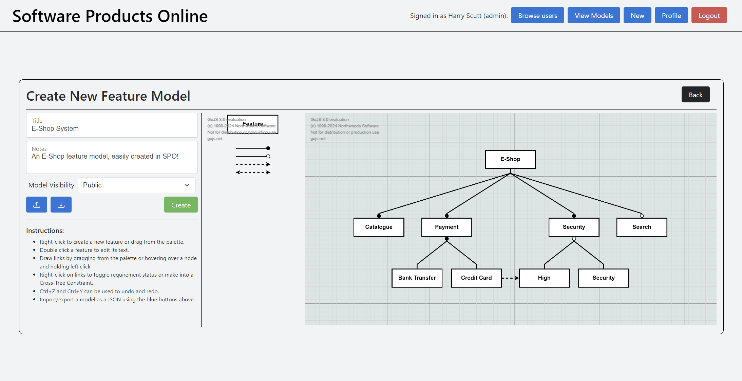
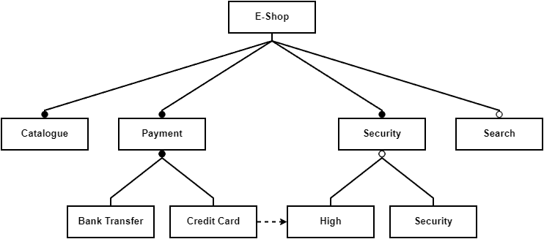
Software Products Online:
Intuitive diagram builder.
Easily accessible Ruby-on-Rails web application.
Can use as guest or member.
Integrated feature model sharing.
Feature model analysis.
Export models as SVG, JPEG, or JSON for sharing outside the application.
Screenshot of an E-Shop system being edited in SPOs feature model builder.
E-Shop diagram from the first slide exported as a JPEG from SPO.

Slide 5
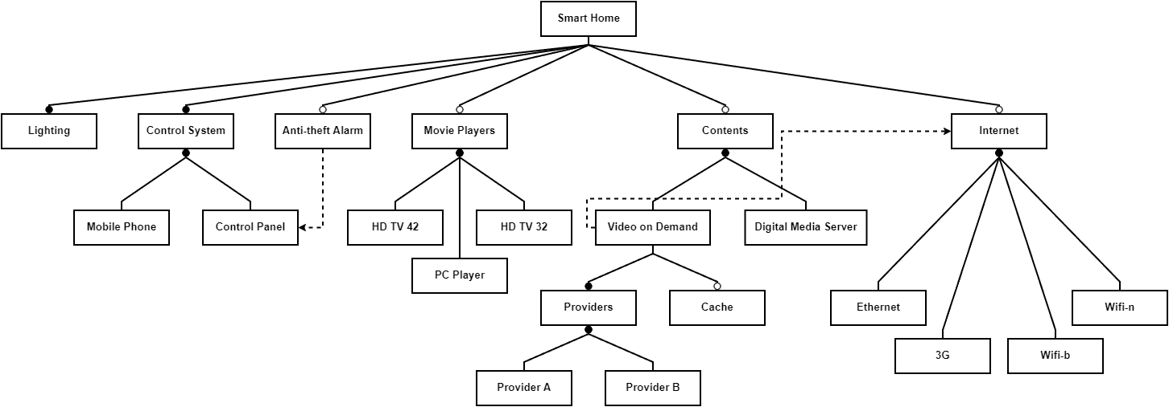
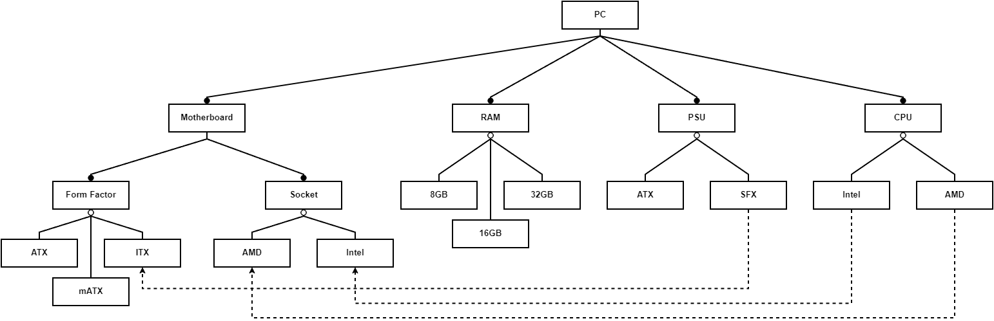
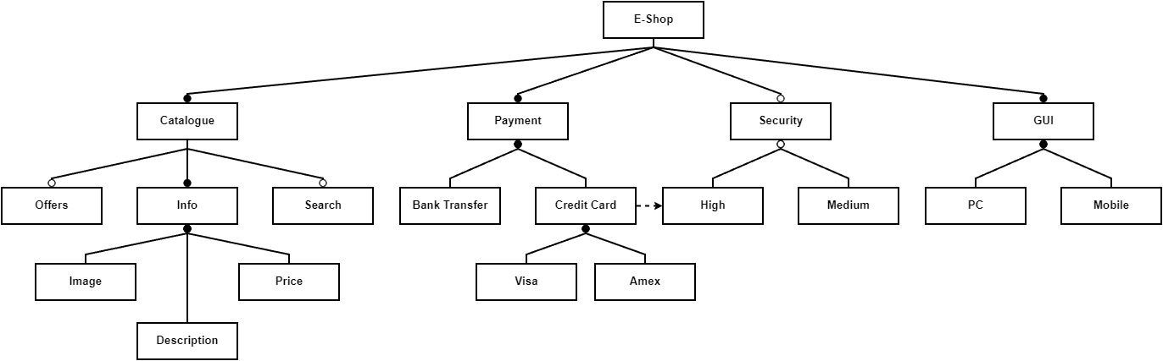
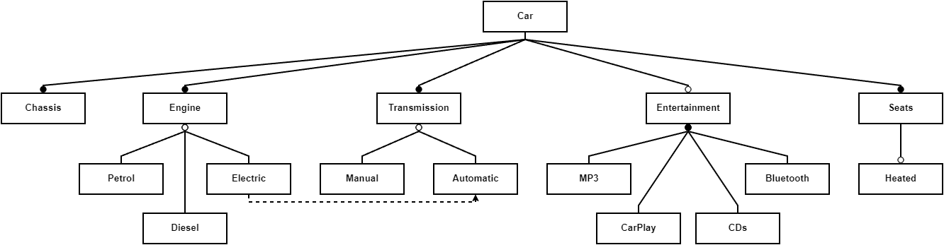
Feature models created in SPO:
Smart Home feature model, recreation of a model initially created using SPLOT.
PC feature model to intuitively demonstrate the language of feature model diagrams.
Advanced extension of the simple E-Shop model found in previous slides.
Car feature model to intuitively demonstrate the language of feature model diagrams.

Slide 6
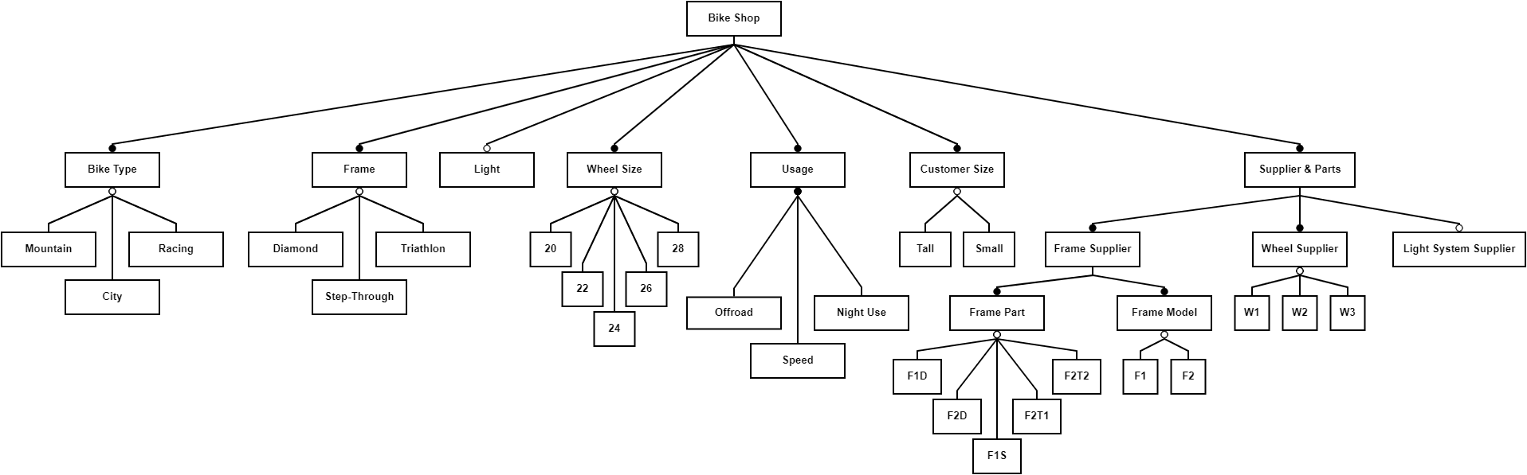
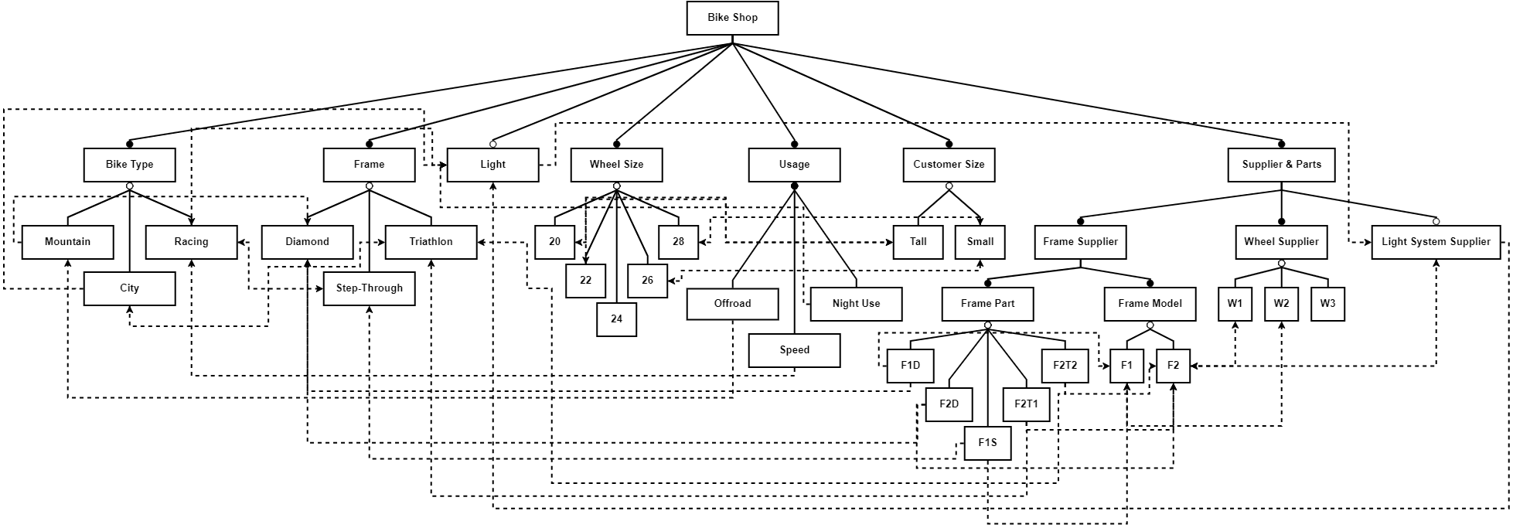
Limitations:
Large models can become visually cluttered when constraints are added (see right).
Difficult to mitigate, requires thoughtful model design.
Number of possible configurations grows exponentially, slowing analysis on feature-dense models.
Prevented by more advanced heuristics or alternate analysis method.
Lack of asynchronous job support in Ruby on Rails means lengthy analysis hogs server resources until complete.
Porting to an asynchronous framework like Node.js could enable cancellation of analysis.
Complex Bike Shop feature model with 39 features and 549,755,813,888 configurations to check.
Above Bike Shop feature model, visually cluttered by numerous Cross-Tree Constraints.

